Slide 1
Unconstrained ordination (PCA, CA, and NMDS)
Multivariate Stats Seminar, UCSB 2021
Robert Fitch
Based on:
UMass Landscape Ecology Lab
McGarigal et al 2000
Wikipedia

Slide 2
Overview
Ordination- simplify complex data by organizing samples along a gradient of interrelated variables, account for major patterns and minimize information loss
Unconstrained- determines patterns without relationships to variables outside of the data set. Analyzing a single set of data, does not determine mechanism.
This is a family of related technique's, method used needs to be critically evaluated for use and desired outcome

Slide 3
Principal Components Analysis
Example data sets:
plant community composition w/ environmental factors
Abundance of animals w/ plant structure data
Animal community data w/ landscape features
Species data and niche parameters

Slide 4
Principal Components Analysis
Important Characteristics:
Continuous gradients
Single set of variables (i.e., no inherent dep. Or indep. variables
Emphasizes variation among samples
Reduces dimensionality from many variables to few composites
Summarizes redundancy and reduce noise
Either all categorical or all continuous
Full rank (no NA’s, and more rows than columns preferred)

Slide 5
Principal Components Analysis- Overview
Condensing information into its principle components
Creating new axes of composite variables
Weighted linear combinations -> maximize variation
Ecological meaning (the importance of each component is defined by the samples)
Generates fully uncorrelated variables that can be used in multiple regression, and MANANOVA

Slide 6
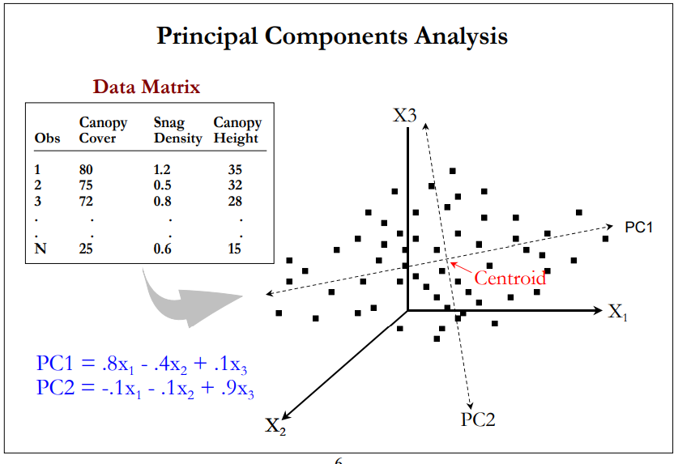
Principal Components Analysis- How it’s Done
Deriving the PCs
1st PC is drawn through the longest portion of the data cloud
2nd is drawn orthogonally
Each subsequent PC…

Slide 7
Principal Components Analysis- How it’s Done
Deriving the PCs
Matrix
Eigen values
Eigen vectors

Slide 8
Principal Components Analysis- How it’s Done
Deriving the PCs
Matrix
Two options- correlation matrix or the covariance
Correlation is almost always most appropriate (equal weight to variances)
Will give different results

Slide 9
Principal Components Analysis- How it’s Done
Deriving the PCs
Eigen values
What is happening?
-Taking a matrix and conducting a linear transformation into a vector

Slide 10
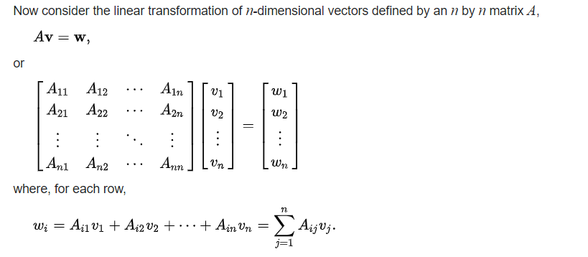

Principal Components Analysis- How it’s Done
Deriving the PCs
Eigen values
Eigen value (non zero, real number)
Correlation matrix

Slide 11
Principal Components Analysis- How it’s Done
Eigen value (non zero number)
Correlation matrix
Deriving the PCs
Eigen values
Scale factor, the magnitude

Slide 12
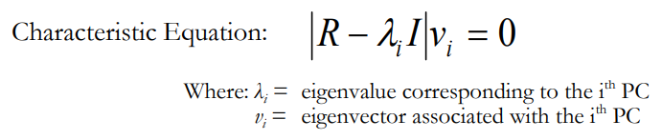
Principal Components Analysis- How it’s Done
Eigen vector
Deriving the PCs
3. Eigen vector
linear transformation of A
How are the Eigen values calculated?

Slide 13
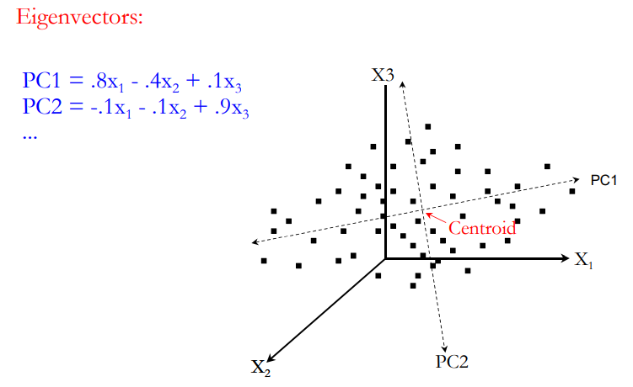

Slide 14
Principal Components Analysis- How it’s Done
Deriving the PCs
Matrix
Correlation matrix
Eigen values
Variance explained by the PC (larger values have more explanatory power
Eigen vectors
The importance of original variables in the PC, the weights of the variables in the linear equations

Slide 15
Principal Components Analysis- How it’s Done
Deriving the PCs
PC Scores?
Location of the samples on the PC
New data for subsequent analyses!
Sum of
Eigen vectors

Slide 16
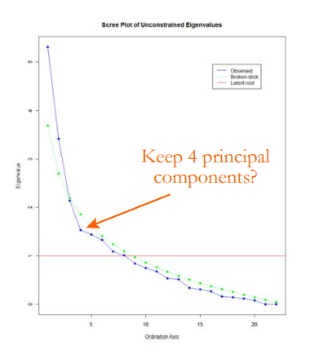
Principal Components Analysis- Assessing the Importance of PCs
Scree Plot
How many PCs should be kept and interpreted?
Latent Root Criterion
Drop any with Eigen values <1
Scree Plot/Broken Stick
Keep PC before becoming linear after sharp decline
Percent Variance Criterion
Want first 3 PCs to explain 70% of variation
Significance Test
Jackknife, bootstrapping
Eigen Values
Ordination Axes

Slide 17
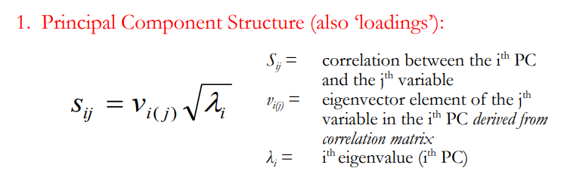
Principal Components Analysis- Interpretation
Structure Coefficients
Component “loadings”- correlation of variables to PCs
As they approach 1, carry similar data as variables
The square of the loading is the %of total variance accounted for by that component

Slide 18
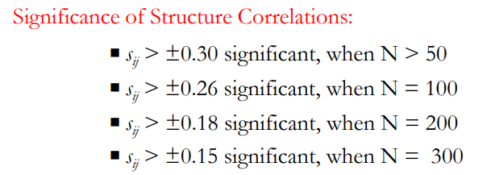
Principal Components Analysis- Interpretation
Structure Coefficients
Rules of Thumb “significance”:
Depends on sample size…
Can use jackknifing and bootstrapping for testing

Slide 19
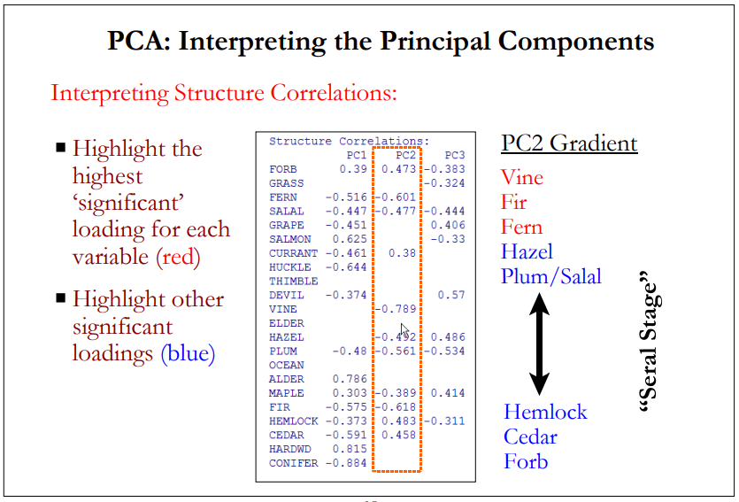

Slide 20
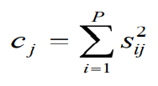
Principal Components Analysis- Interpretation
Communality
Highly recommended to use
The proportion of the variable’s variance explained by PC
0 < c < 1
“how well the original variables are accounted for”

Slide 21
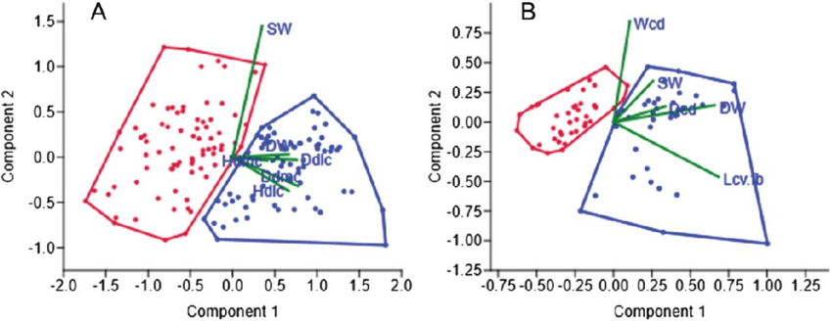
Principal Components Analysis- Interpretation- Graphing PC Scores

Slide 22
Principal Components Analysis- Assumptions
Multivariate normality
Indep. And random samples
Linearity
Outliers*
Sample Size*
Your goal?-
Descriptive vs inferential?

Slide 23
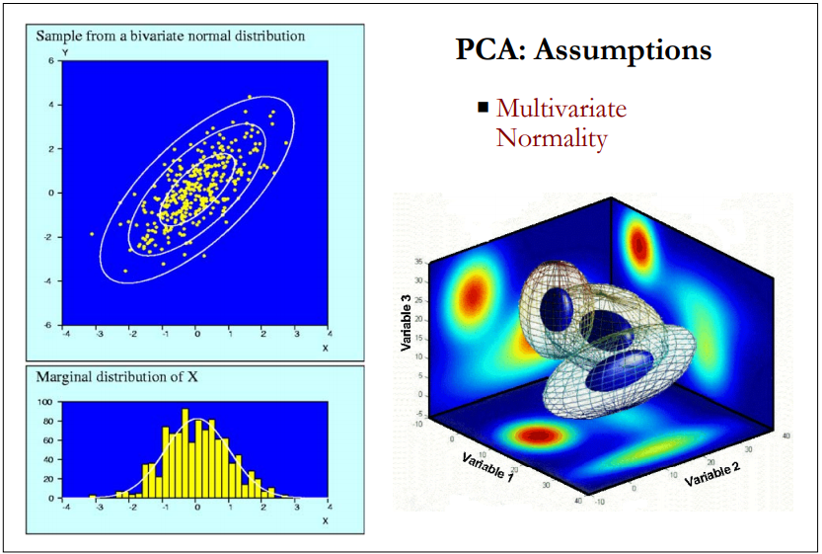
Principal Components Analysis- Assumptions
Multivariate normality
Data are hyper-ellipsoid and the density of the data is anchored in a centroid
Diagnostics?- QQ plots, boxplots, histograms
Each variable and the PC scores
Univariate normal does ensure MVN
Checking for skewness, kurtosis, normal dist. For each variable

Slide 24
Principal Components Analysis- Assumptions
2. Indep. And random samples (addressed by conducting an appropriate study design, random stratified sampling)

Slide 25
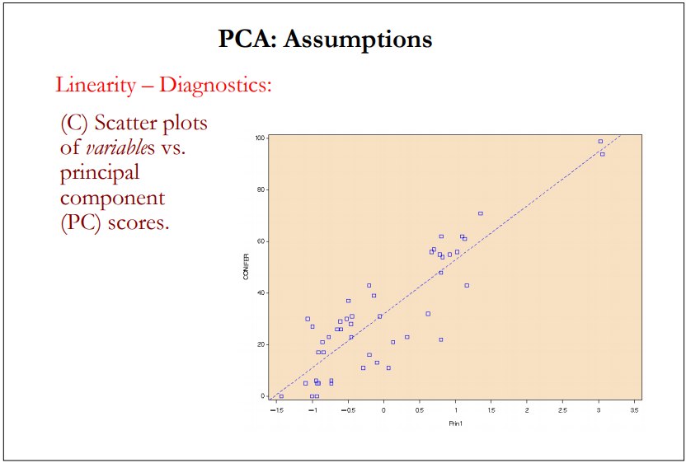
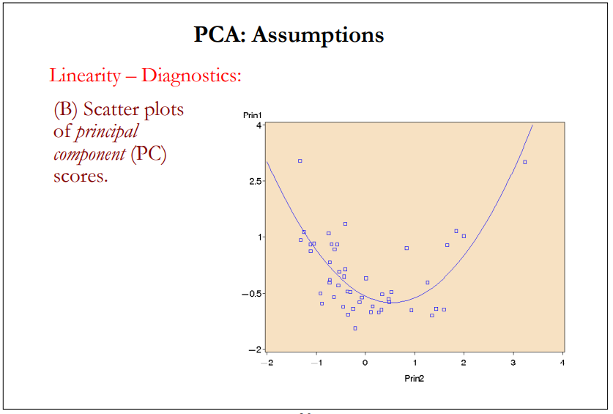
Principal Components Analysis- Assumptions
Linearity
The variables change linearly across the gradients
Scatter plots of variables vs PC scores and PC scores for each PC

Slide 26
Principal Components Analysis- Assumptions
Outliers*
Can have large effects on analysis, and should be removed >> data screening

Slide 27
Principal Components Analysis- Assumptions
Sample Size*
General Rules of Thumb:
More sample than variables
Should always be large enough to adequately describe your study/questions
Specific calculation: N > 3 * P
Eliminate unimportant variables

Slide 28
PCA and Limitations
Long/large gradients can result in patterns being distorted
Best used in narrow range
Could miss information if dismissing PCs
Redundant variables increase variance explained but could be totally ignorant of the data
Not recommended for community data

Slide 29
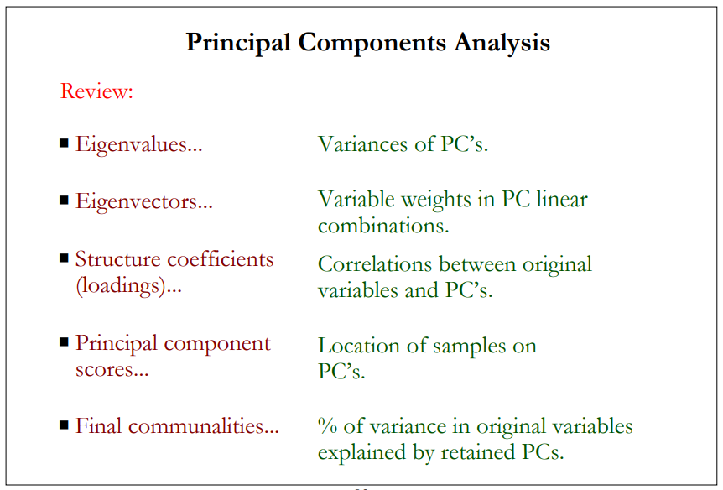
PCA Terminology Summary

Slide 30
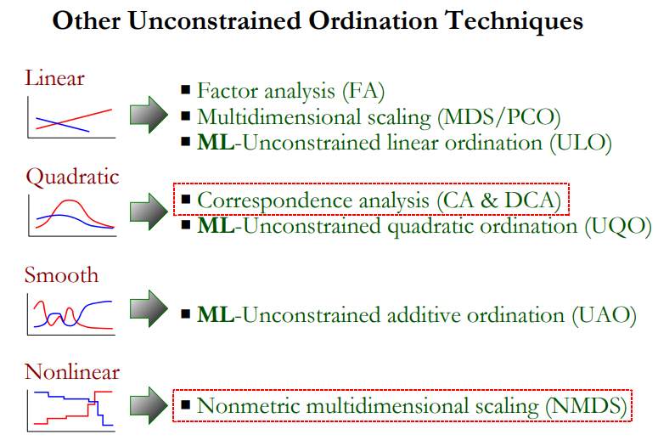

Slide 31
Correspondence Analysis (CA)
Overview:
Simultaneous ordination of samples to maximize correlation between samples and species
Still uses Eigen values/vectors
PCs are a linear combination of variables
Except uses two sets one calculated from the species and one for the sample (not Euclidean, uses Chi-square distances- inertia)

Slide 32
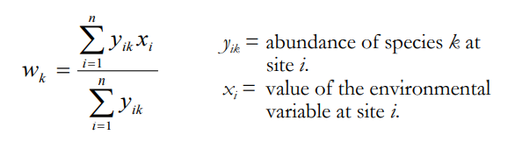
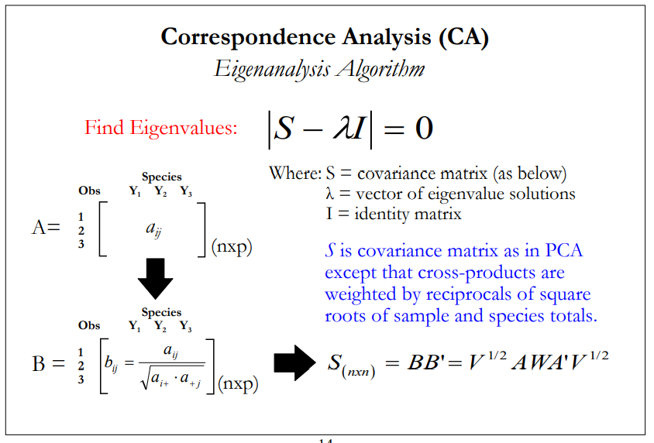
Correspondence Analysis (CA)
Overview:
Estimates the optima if X has a uniform and symmetric distribution.
Unbiased estimate

Slide 33
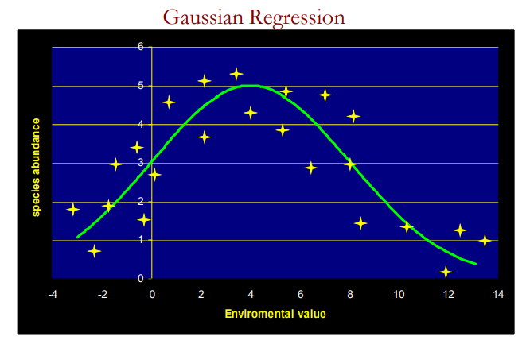
Correspondence Analysis (CA)
Assumptions:
Species are unimodal, optima are equal, have equal tolerances, and are evenly spaced

Slide 34
Correspondence Analysis (CA)
Limitations:
Species’ responses must be unimodal and similarly scaled…
Extreme values are compressed towards center (compression)
Ordination is done sequentially appearing as an arch (no ecological basis) – arching effect
Can resolve issue of compression and arch by detrending CA, however methods are criticized…
Chi square distance is heavily criticized for community data

Slide 35
NMDS
Non-metric multidimensional scaling
Eigen analysis but of a dissimilarity matrix
No linear assumptions (uses rank order)

Slide 36
NMDS
Algorithm
Searches for best positions of k dimensions (axes) in order to minimize stress
Stress = departure from monotonicity (only increasing/decreasing, preserving order) i.e., representation of original data
Euclidean distances

Slide 37
NMDS
Algorithm
Calculates dissimilarity matrix (Bray-Curtis)
Assigns random configuration (of axes and samples in p-space)
Calculate Euclidean distances, rank elements
Calculate stress (goodness-of-fit)
Reconfigure to minimize stress until stable solution is reached

Slide 38
NMDS
Checking validity
# of dimensions
Fit based R2
Influential samples
Stable solution

Slide 39
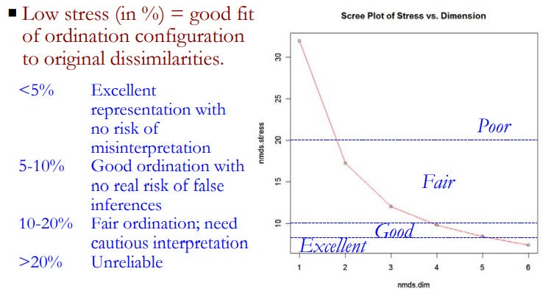
NMDS
1. Choosing #of Dimensions
Changes solutions! (not unique)

Slide 40
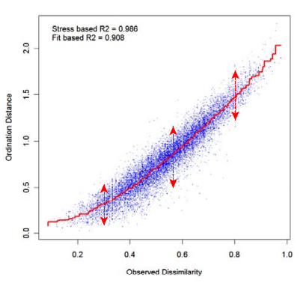
NMDS
2. Fit Based R2
Should be a staircase

Slide 41
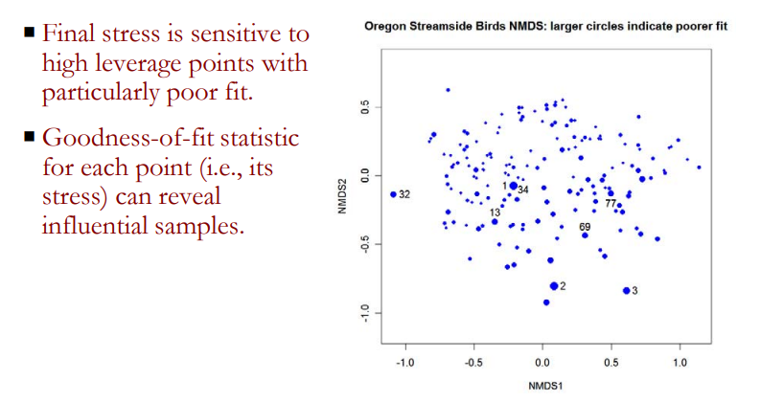
NMDS
3. Influential samples

Slide 42
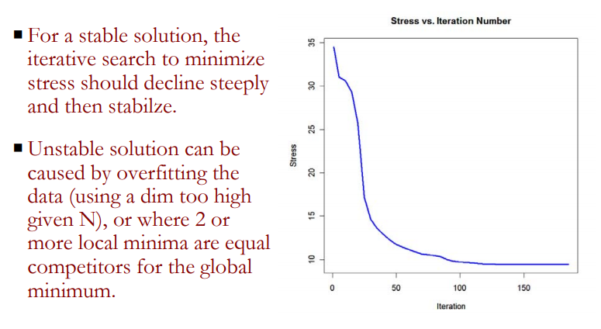
NMDS
4. Stable Solution

Slide 43
NMDS
Strengths
No assumptions of linearity or distribution of species or responses
Unbiased and faithful to original data structure
Most suitable of community data
Weaknesses
Not based on an ecological model
Sensitive to misspecification
Axes do not contain inherent information

Slide 44
